Slide 1

Wire Tap A Man In The Middle Attack Framework
Joel Prentice

Slide 2
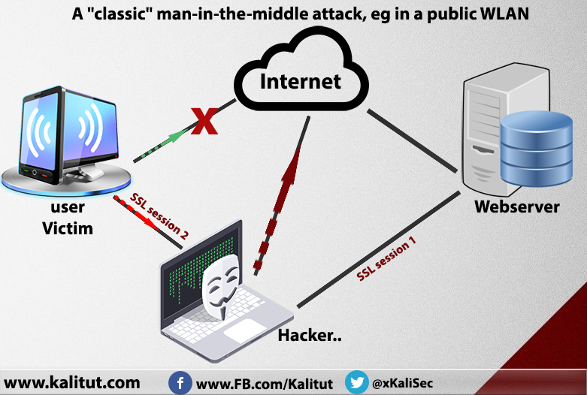

Man in the Middle Attacks
Makes keeping data secure and private challenging.
Attacker sits between the victim and the router.
Monitors all traffic coming over the wire.
Attacker takes over communication process, copies or alters it, then passes it along to the recipient.

Slide 3
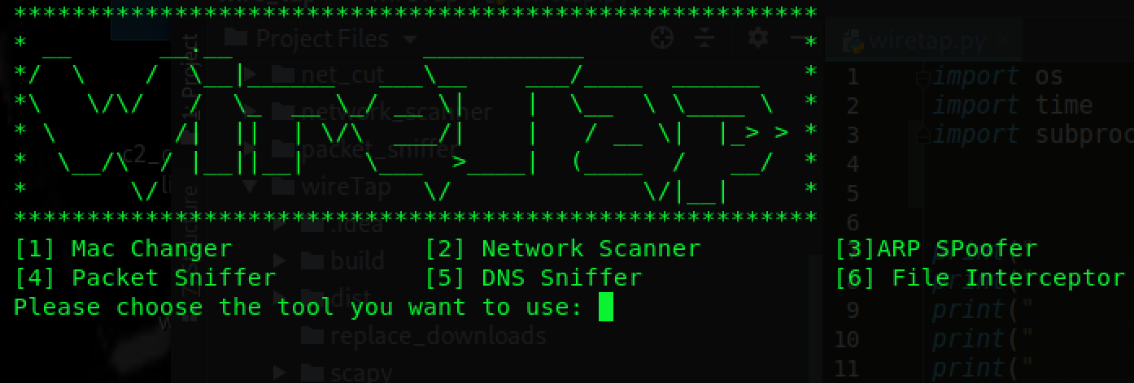
Wire Tap
A Man in the Middle Attack Framework
Man in the Middle attack framework.
Provides users with all the tools needed to perform Man in the Middle attacks.
Written in Python and is platform independent
Contains:
Network scanner
MAC Changer
ARP Spoofer
DNS Spoofer
Packet Sniffer
File Interceptor
Code Injector

Slide 4

Why Create Wire TAP
Man in the Middle Attacks have many moving parts and can be complicated.
Tools are learned individually but are not often tied together.
Allows users to see how different tools compliment each other.
Gain a better understanding of Man in the Middle Attack methodology.

Slide 5
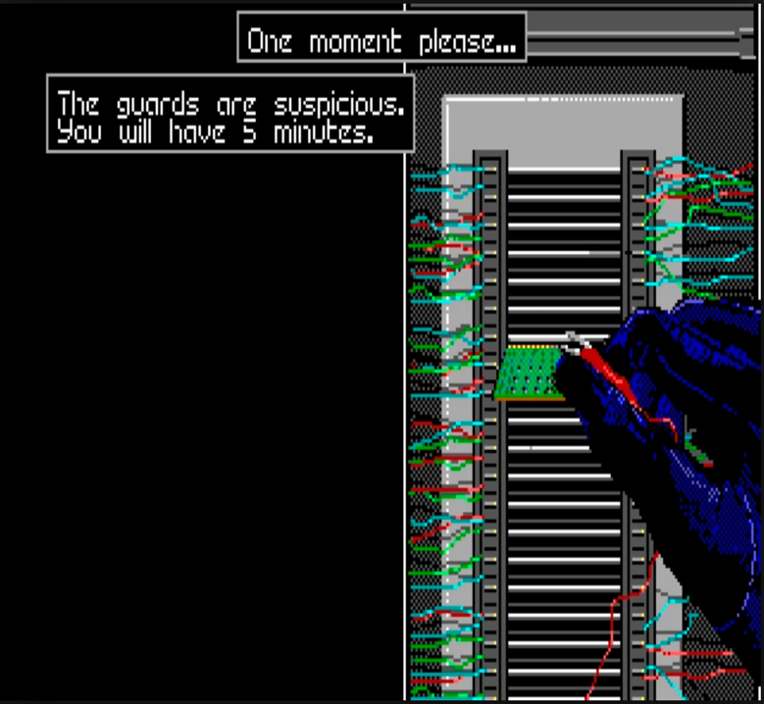
Benefits Of Using Wire Tap
Modular and easily extendable.
Ability to create and deploy new attack types
Users can mold and morph wire Tap into what they need it to be.

Slide 6
Network Scanner

Slide 7
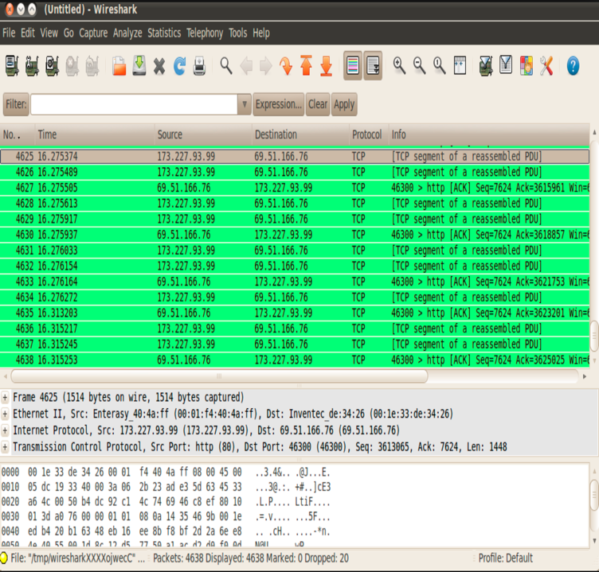
What is A Network Scanner?
Discover active devices on the network.
Print IP and MAC address information to the users screen.
This is done using the ARP method using the Python module scapy.

Slide 8
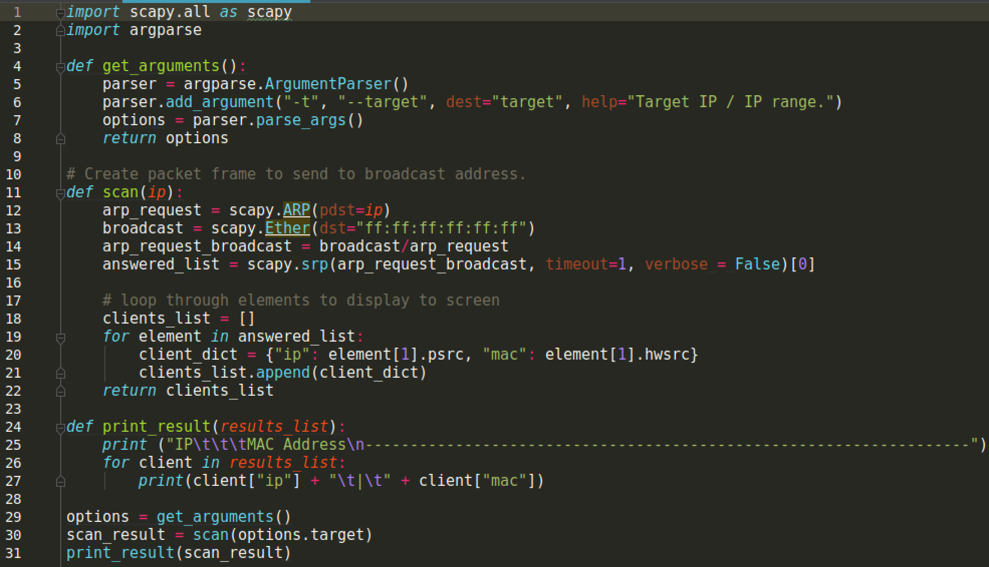
The Algorithm
ARP Request created that asks for IP and receives response over the network is made of two parts:
Asks targets who has an IP within the network range.
Sets the destination MAC to broadcasts its MAC address
Request is sent then waits to receive responses.
Response is parsed using a list and dictionary
Print IP and MAC addresses to the screen.

Slide 9
MAC Changer

Slide 10

What Is The MAC Address?
MAC addresses are assigned to a Network Interface Card (NIC) by the manufacturer and are permeant.
MAC addresses are unique to the device it is assigned, no two devices will have the same MAC address.
Because the MAC address is unique if multiple MAC’s are found on the network it will raise suspicions.

Slide 11
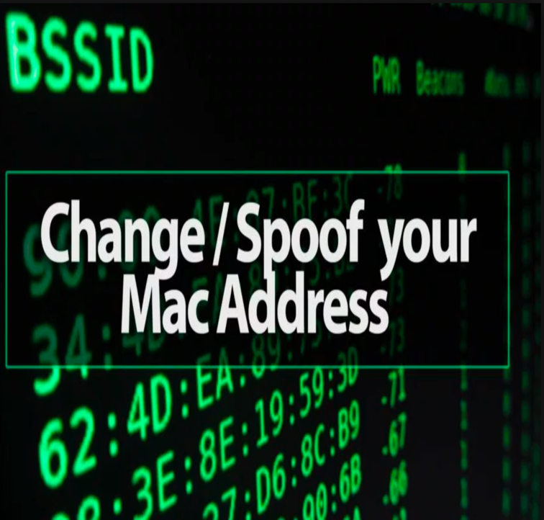
Why Spoof Your MAC Address?
Absolute untraceable scans.
Test redirection of network traffic, and Access points.
Gain unauthorized entry to networks that filter by MAC address.
Move through the network without drawing attention to yourself.

Slide 12
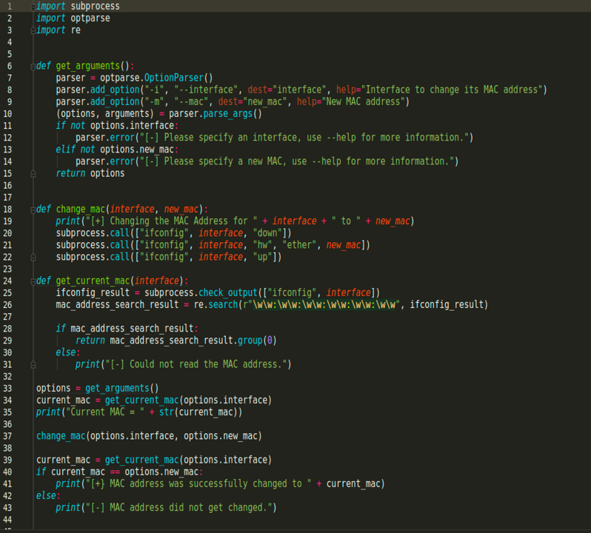
The Algorithm
The goal of the algorithm is to check if the MAC has been changed!
Execute and read the ifconfig / ipconfig output.
Uses Regular Expressions to read the MAC address from the output.
Checks if the MAC in ifconfig / ipconfig matches the input.
If no match is found then the MAC is changed.
Results are then printed to the screen.

Slide 13
ARP Spoofer

Slide 14
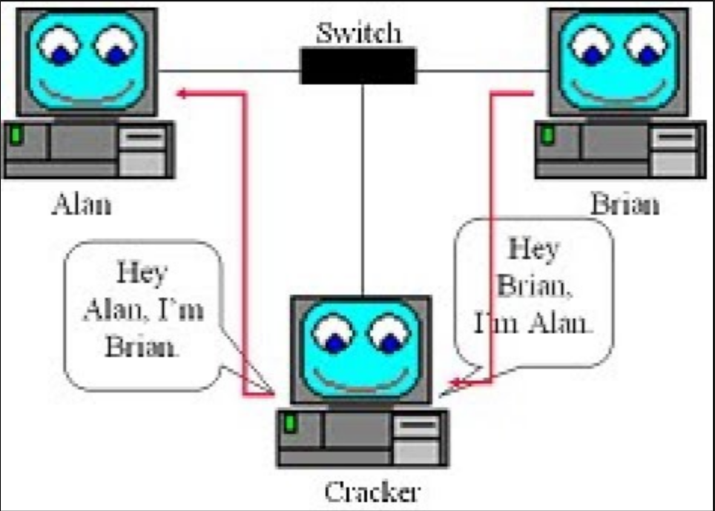
What is ARP spoofing?
ARP Translates an Ipv4 address to a destination MAC address.
Carried out over a Local Area Network (LAN)
Attacker sends malicious ARP packets to a default gateway to change the pairings in its IP to MAC address table.
ARP reply messages are sent to the default gateway stating his MAC address should be associated with the victims IP address.
Traffic for the target to or from other devices on the network now travels through the attacker.

Slide 15
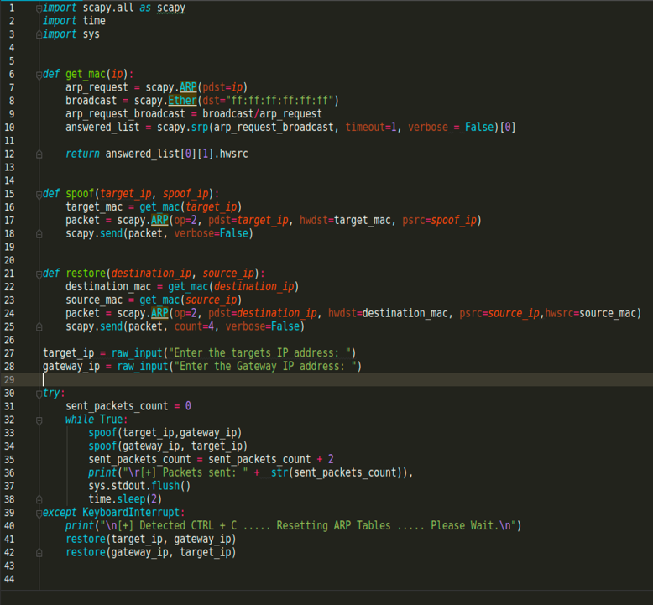
The Script
Uses three functions to perform attack.
get_mac()
scapy.ARP request with targets IP address
scapy.Ether request with the destination MAC
Variable arp_request_broadcast used to broadcast the target IP address and receive the target MAC address.
spoof()
Uses get_mac() to obtain the targets MAC address.
ARP packet is built with the packets destination, hardware destination, and packet source.
Packet is then sent over the network to start attack.
restore()
Responsible for resetting the ARP table so that normal network activity connectivity will commence.
First, Destination MAC is obtained along with the source MAC address
An ARP packet is crafted with the packet destination, hardware destination, packet source, and hardware source.
Packet is then sent over the network .
Updates the ARP table so the proper devices have the proper MAC address associated with their IP address

Slide 16
Packet Sniffer

Slide 17
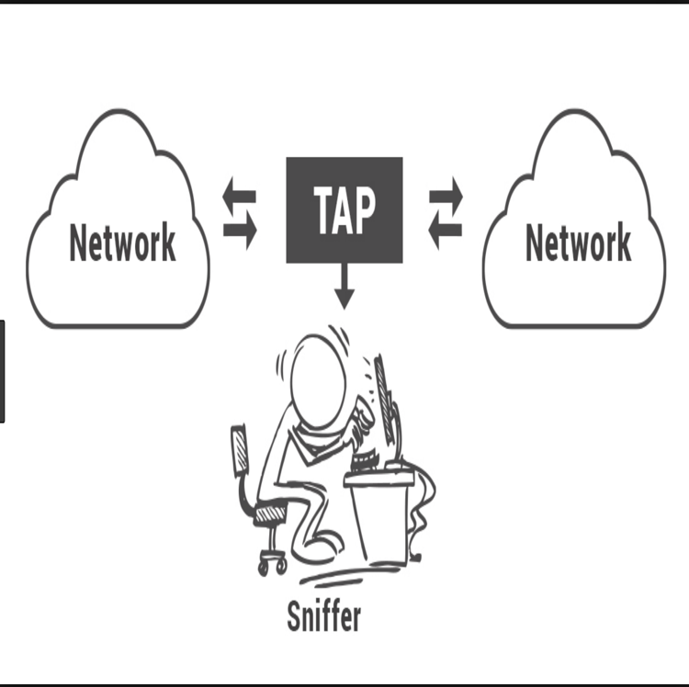
What Is A Packet Sniffer?
A piece of software that is used to monitor network traffic.
Examines data packets that flow between computers on a network and computers and the larger network.
Allows IT professionals and Malicious intruders to examine packets.
Configured for either filtered or unfiltered packet capture.

Slide 18

How Does It Work?
The packet sniffer will capture data flowing through the specified interface.
As interesting information such as login info, visited websites, and images are found they will be printed to the console window.
Captures data being sent to and from the interface card.
Used in conjunction with ARP spoofer
Once you have collected interesting data from a target you can move to another target on the network.

Slide 19
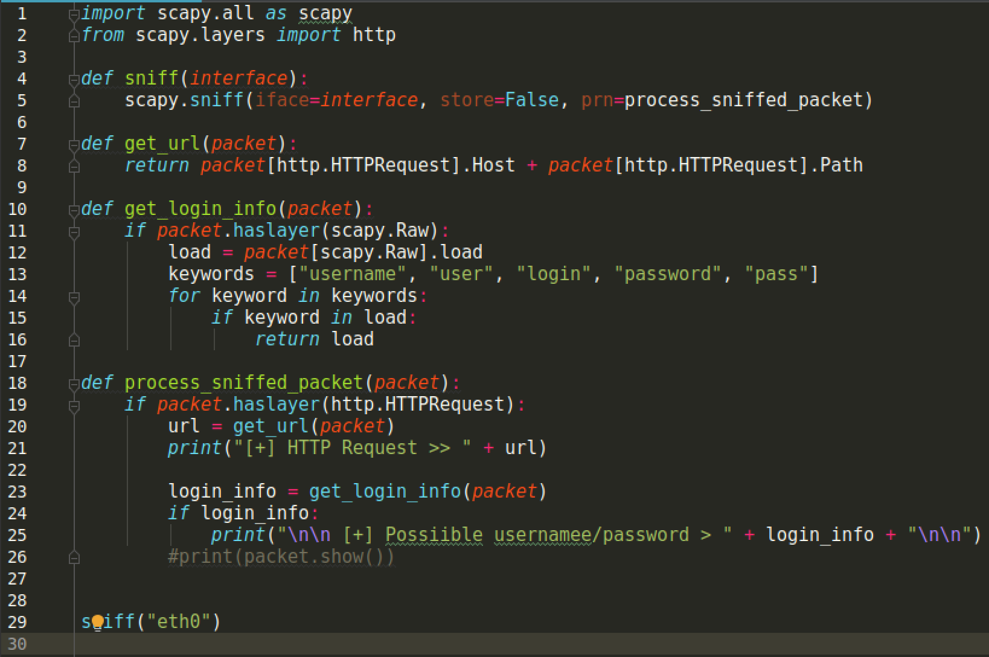
The Script
The packet sniffer script consists of four functions.
Sniff()
Uses prn to pass a function that executes with each packet sniffed.
This replaces the default packet printing display with a format of your choosing.
Get_url()
Obtains URL’s from packets and then returns the URL.
Get_login_info()
Captures packets in their raw form.
Searches packets for keywords
If keywords are found then they are stored and returned.
Process_sniffed_packet()
Prints URL’s and login information that was captured to the console window.

Slide 20
DNS Spoofer

Slide 21
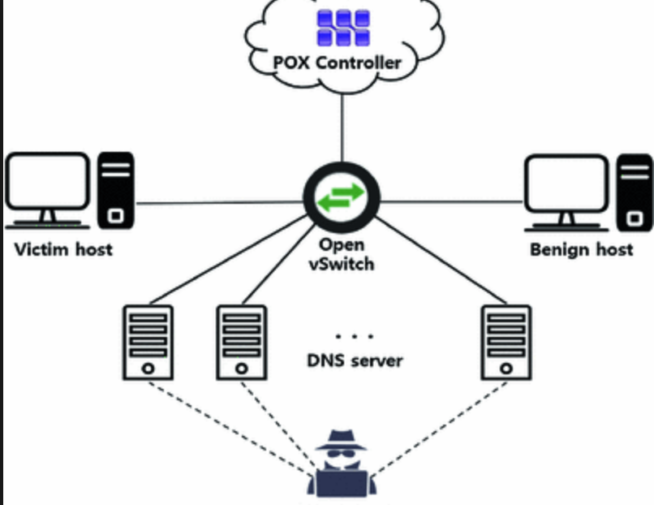
What Is DNS Spoofing
Occurs when attackers insert a fake address record for an internet domain into DNS.
When fake records are accepted by the server, the cache becomes poisoned and subsequent requests for the address of the domain are answered with the address of a server controlled by the attacker.
As long as the entry is cached users will be redirected to the address provided by the compromised DNS server.
DNS wildcards can be used which are typically used to guide mistyped or errant emails to an intended destination.

Slide 22
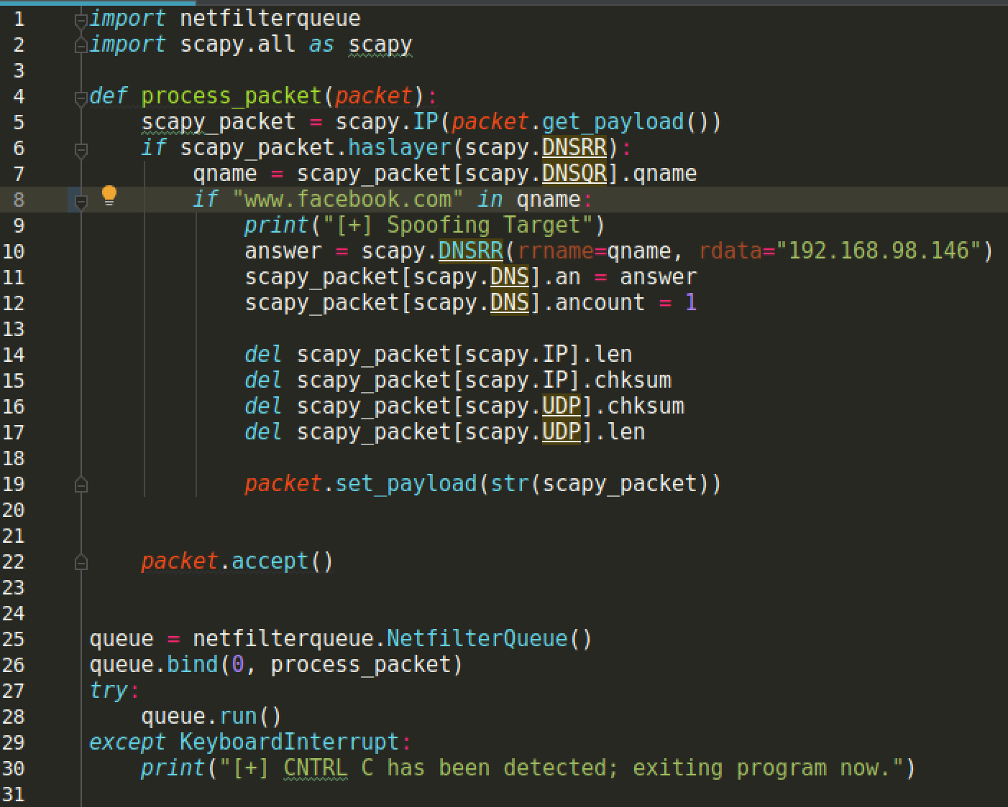
The Script
Process_packet()
When a DNS request is sent, the DNS query is stored in a variable.
If the variable has the URL www.facebook.com in it then the user will see a message that the target is being spoofed.
The IP and UDP values are then deleted from the packet that is created then the packet payload is set and deployed.
A queue system is used to intercept and analyze packets as they pass through to see if they have the keyword facebook in them.
Packets for facebook.com are modified and sent to the spoofed site, otherwise they are sent normally as requested.

Slide 23
File Interceptor

Slide 24

What Is A File Interceptor
Analyzes traffic coming from a victim machine to see when a download request is made.
Changes request location to a site that hosts malicious files such as:
Credential Harvester
Back door
Keylogger
Effective because as far as the user knows they are downloading what they asked for.

Slide 25
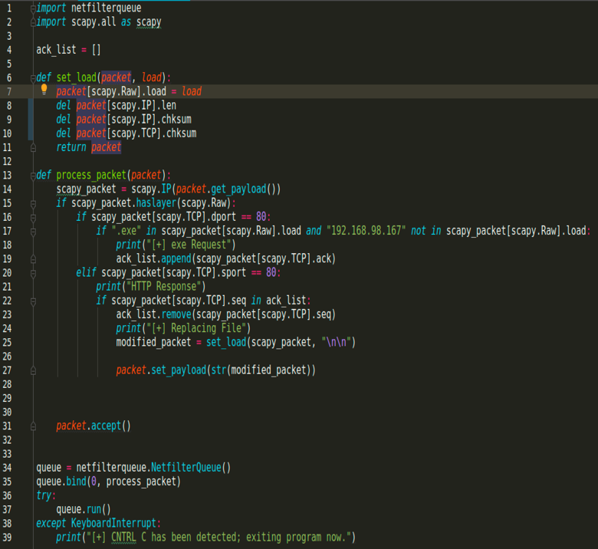
The Script
The file utilizes two functions
Set_load()
Loads raw scapy packet and then modifies fields that will be made to the packet.
In the IP layer the length and checksum fields are deleted.
Process_packet()
Packets are inspected to see if they have a raw layer.
Destination port in raw layer is inspected to see it equals 80.
Traffic going to port 80 is then examined to see if the keyword “.exe” is in the load field of the packet.
If “.exe” is in the load field the ack value is added to an ack list.
Responses are then also examined to see if it equals 80.
If it is going to port 80 the sequence value is added to the ack list
Sequence and Ack examined for a match.

Slide 26
Code Injector

Slide 27
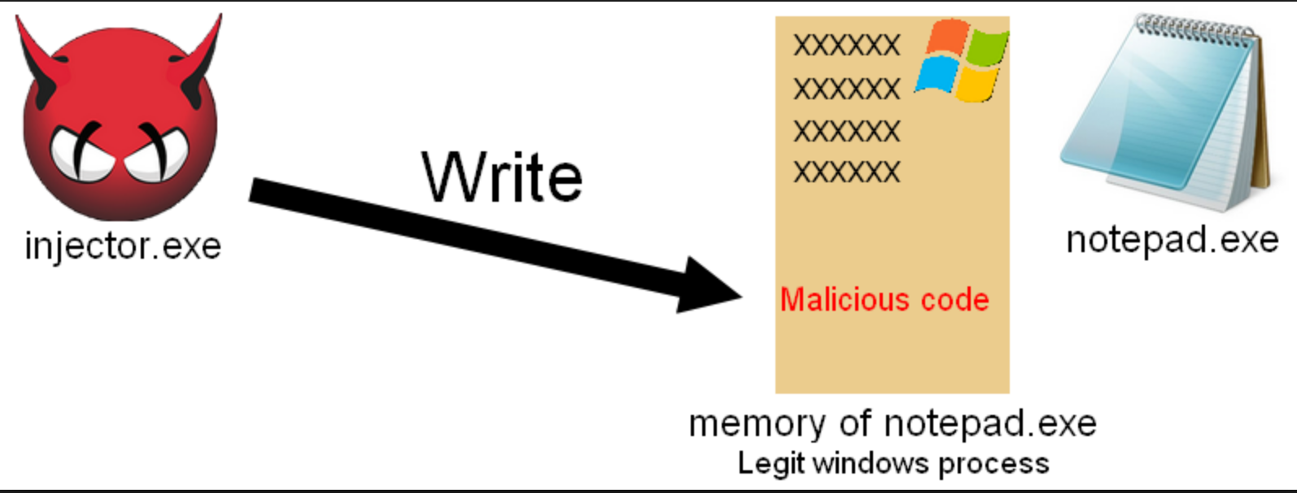
What Is A Code Injector
Introduces malicious code into a computer program.
One of the most critical classes of attacks
Can be found in different layers
Covers a wide range of security issues.
The purpose of the code injector is to inject a credential harvestor into the HTML found in the response packets raw layer.

Slide 28
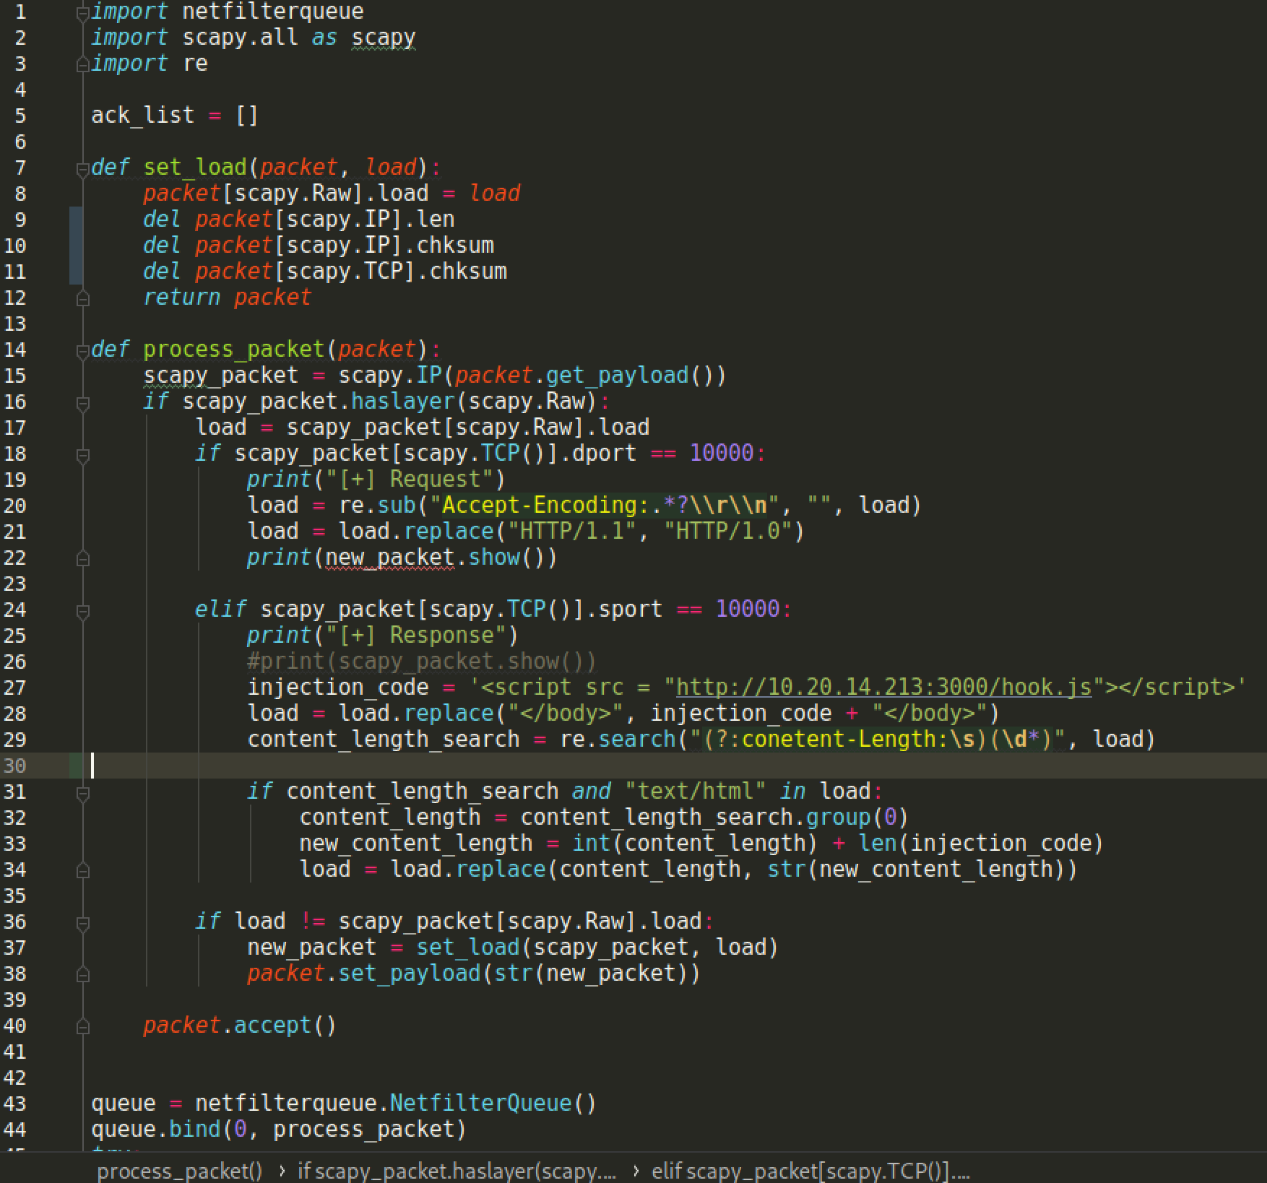
The Script
The code injector uses two functions
Set_load()
Loads raw packet
In the IP layer the length and checksum fields are deleted.
In the TCP layer the checksum field is deleted.
Process_packet()
Analyzes the response packets and decodes the load field in the raw layer.
Accept-Encoding is removed from packet header
This allows the clear text of HTML code to be viewed.
Python replace function used on the load field.
Malicious code is inserted in front of the closing body tag.

Slide 29



THANK YOU
Joel Prentice
jdprenti@Utica.edu

Slide 30
References
Alberto Ornaghi, M. V. (2003). Man in the middle attacks. Retrieved from Blackhat: http://arnaud.labenne.free.fr/pdf/bh-europe-03-valleri.pdf
Anonymous. (2008, October 20). How DNS cache poisoning works. Retrieved from Network World: https://search.proquest.com/docview/223736374?accountid=28902
ARP Poisoning. (N.D.). Retrieved from radware: https://security.radware.com/ddos-knowledge-center/ddospedia/arp-poisoning/
Cardenas, E. D. (2003, August 2003). GIAC. Retrieved from MAC Spoofing an Introduction: https://www.giac.org/paper/gsec/3199/mac-spoofing-an-introduction/105315
Franco callegati, W. c. (2009, Jan - Feb 2009). Man-in-the-Middle Attack to the HTTPS Protocol. Retrieved from IEEE Security & Privacy: http://ieeexplore.ieee.org/stamp/stamp.jsp?tp=&arnumber=4768661&isnumber=4768640

Slide 31
Gangan, S. (2015, April 08). 1A Review ofMan-in-the-Middle Attacks. Retrieved from Arxiv: https://arxiv.org/ftp/arxiv/papers/1504/1504.02115.pdf
Goli, S., & Thangaraju, B. (2019, March 1). Insight - Admin: How Man in the Middle Attacks Cause Damage. Retrieved from Open Source for You: https://search.proquest.com/docview/2202162901?accountid=28902
Hoffman, C. (2017, July 3). How-T0 Geek. Retrieved from How (and Why) to Change Your MAC Address on Windows, Linux, and Mac: https://www.howtogeek.com/192173/how-and-why-to-change-your-mac-address-on-windows-linux-and-mac/
Man-in-middle Attacks Pose Threat in Healthcare. (2017, June). Retrieved from proquest: https://search.proquest.com/docview/1985643609?accountid=28902
Mitropoulos, D., & Spinellis, D. (2017, November 27). Fatal injection: a survey of modern code injection attack countermeasures. PeerJ Computer Science. Retrieved from Mitropoulos, Dimitris; Spinellis, Diomidis.

Slide 32
Phishers Turn To DNS Wildcards, Cache Poisoning; Phishers are using ever-more-sophisticated tactics, including DNS wildcards and cache poisoning to separate consumers from their money, a British security firm said Tuesday. (2005, March 8). Retrieved from InternetWeek. : http://go.galegroup.com.ezproxy.utica.edu/ps/i.do?p=AONE&u=nysl_ce_uticacol&id=GALE|A129944918&v=2.1&it=r&sid=oclc
Scapy Sniffing with Cusotm Actions. (2013, October 02). Retrieved from thePacketGeek: https://thepacketgeek.com/scapy-sniffing-with-custom-actions-part-1
Subprocess Management. (N.D.). Retrieved from Python: https://docs.python.org/2/library/subprocess.html
What is a Packet Sniffer? (N.D.). Retrieved from Kaspersky: https://usa.kaspersky.com/resource-center/definitions/what-is-a-packet-sniffer
countermeasures. PeerJ Computer Science, doi:http//dx.doi.org/10.7717/peerj-cs.136
Thurimella, R., & Mitchell, W. (2009). Cloak and dagger: man-in-the-middle and other insidious attacks. International Journal of Information Security and Privacy, 3(3), 55+. Retrieved from http://link.galegroup.com/apps/doc/A210920514/AONE?u=nysl_ce_uticacol&sid=AONE&xid=3408a671
Goli, S., & Thangaraju, B. (2019, Mar 01). Insight - admin: How man in the middle attacks cause damage. Open Source for You, Retrieved from https://search.proquest.com/docview/2202162901?accountid=28902

